Slide 1




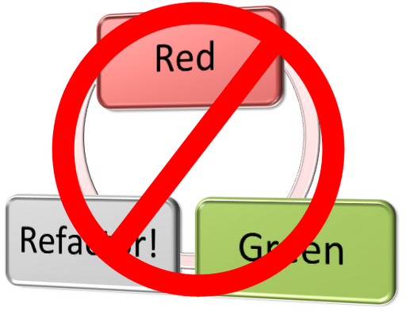
Test-Driven Development
Learn the "Test First"
Approach to Coding
High-Quality Code
SoftUni Team
Technical Trainers
Software University
http://softuni.bg

Slide 2

Table of Contents
Code and Test
Test-Driven Development
Reasons to use TDD
Myths and Misconceptions about TDD

Slide 3

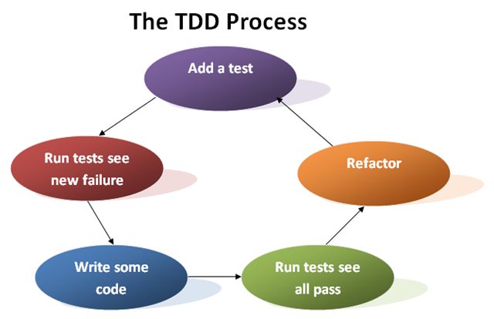
Code and Test vs. Test-Driven Development

Slide 4
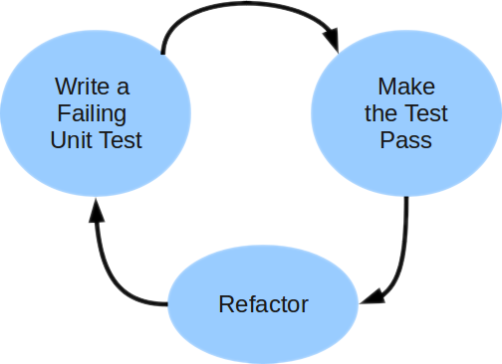
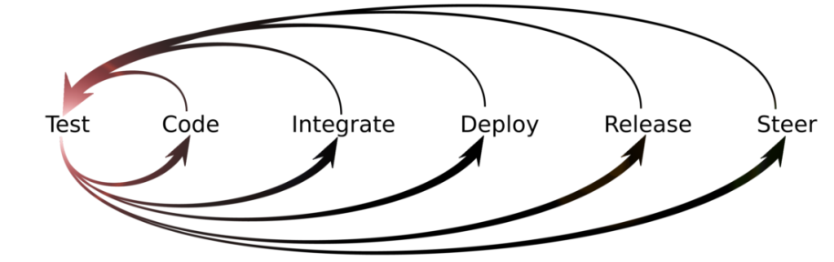
Unit Testing Approaches
"Code First" (code and test) approach
Classical approach
"Test First" approach
Test-driven development (TDD)

Slide 5
The Code and Test Approach
Write code
Write unit test
Run and succeed
Time flow

Slide 6
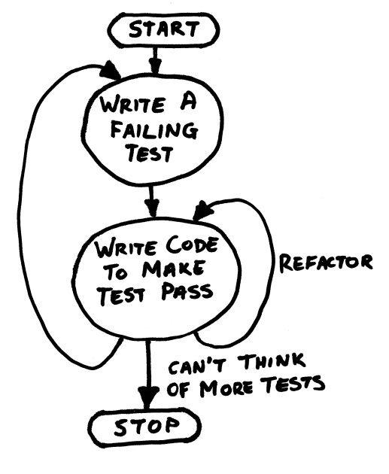
The Test-Driven Development Approach

Slide 7
Test-Driven Development (TDD)
Create a test list
Pick а test
Write test
Compile and fail
Write enough code to compile
Run test and fail
Write code to pass test
Time flow
Remove duplication

Slide 8


Why TDD?
TDD helps find design issues early
Avoids reworking
Writing code to satisfy a test is a focused activity
Less chance of error
Tests will be more comprehensive than if they are written after the code

Slide 9
Myths and Misconceptions
You create a 100% regression test suite
The unit tests form 100% of your design specification
You only need to unit test
TDD is sufficient for testing
TDD doesn't scale (partially true)
Your test suite takes too long to run
Not all developers know how to test
Everyone might not be taking a TDD approach

Slide 10
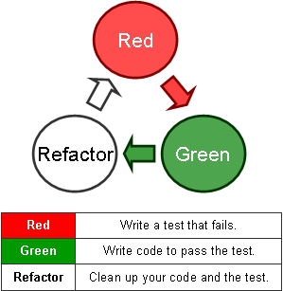
Test-Driven Development
Live Demo: Tree

Slide 11

Test-Driven Development
Exercises in Class

Slide 12

Summary
Code and Test
Write code, then test it
Test-Driven Development
Write tests first
Reasons to use TDD
Prevent some application design flaws
Manage complexity more easily

Slide 13









Test-Driven Development
http://softuni.org/courses/high-quality-code

Slide 14

License
This course (slides, examples, demos, videos, homework, etc.) is licensed under the "Creative Commons Attribution-NonCommercial-ShareAlike 4.0 International" license
Attribution: this work may contain portions from
"Fundamentals of Computer Programming with C#" book by Svetlin Nakov & Co. under CC-BY-SA license
"C# Part I" course by Telerik Academy under CC-BY-NC-SA license

Slide 15






Free Trainings @ Software University
Software University Foundation – softuni.org
Software University – High-Quality Education, Profession and Job for Software Developers
softuni.bg
Software University @ Facebook
facebook.com/SoftwareUniversity
Software University @ YouTube
youtube.com/SoftwareUniversity
Software University Forums – forum.softuni.bg

